Slide 1
Stock Price Prediction System
Leveraging LSTM (Long Short Term Memory) Algorithm
Presented By:
Aadarsha Upadhyaya

Slide 2
Introduction
Solves Vanishing Gradient Problem:
It overcomes the issue in traditional RNNs where information gets “forgotten” over time.
Memory Cells:
It uses memory cells to store information for long durations, allowing the model to remember important patterns.
Gates Mechanism:
LSTMs use three types of gates – input, forget, and output gates – to control the flow of information.
Applications:
It is effective in tasks like language modeling, time series forecasting, speech recognition, and more
LSTM which stands for Long Short Term Memory, is a type of specialized Recurrent Neural Network (RNN) designed to handle long-term dependencies in sequential data and is aimed at mitigating the vanishing gradient problem commonly encountered by the traditional RNNs.
-Wikipedia

Slide 3
Problem in Traditional RNNs
Vanishing Gradient Problem
During training, gradients (used to update weights) shrink exponentially as they are back-propagated through time, making it harder for the model to learn long-term dependendencies.
For example:
In a sentence, if you try to predict a word based on words that are far apart (e.g., “The cat sat on the mat”), the model struggles to remember “The” when predicting “mat”

Slide 4
Problem in Traditional RNNs
Exploding Gradient Problem
Sometimes, gradients grow too large during backpropagation, leading to unstable training where the model’s weights become excessively large and cause errors.
For Example:
If the model tries to predict a sequence of events (like stock price), large gradients could cause sudden jumps in predictions, making the model unstable and unreliable.

Slide 5
Problem in Traditional RNNs
Short Term Memory
Traditional RNNs are better at learning short-term dependencies but fail to retain information over long sequences, which limits their performance in tasks like text generation or machine translation.
For example:
An RNN trained to predict the next word in a sentence might forget the context of the entire sentence and focus only on the most recent word.

Slide 6
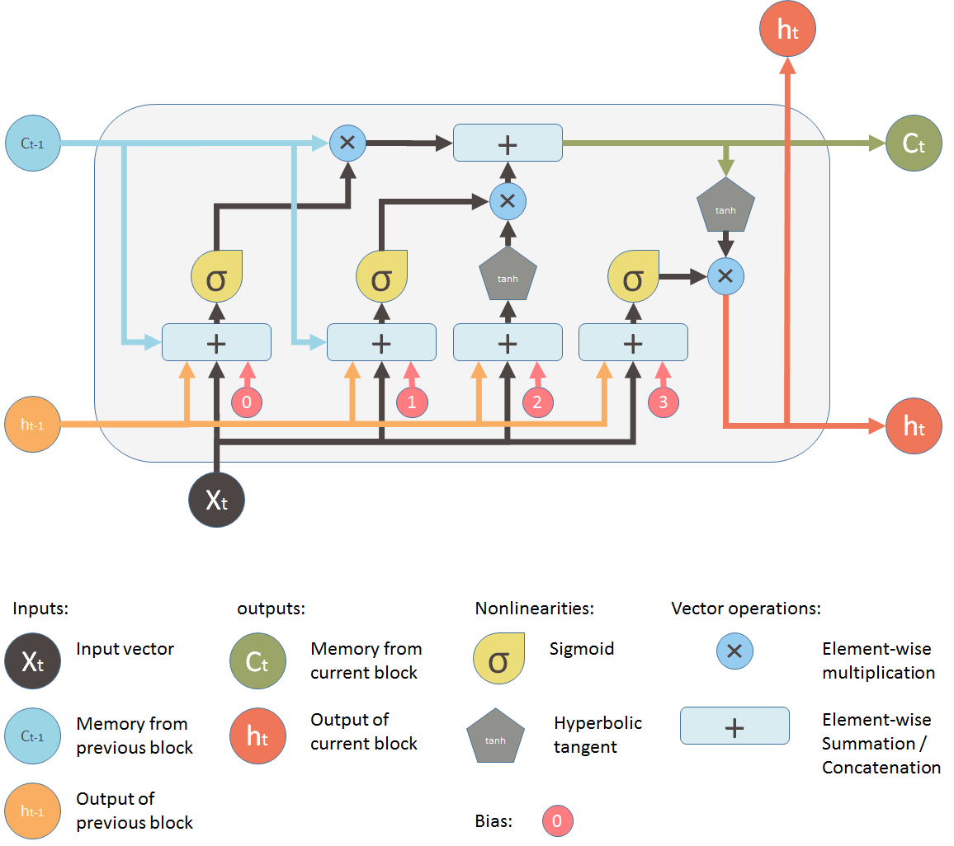
Architecture of LSTM
Source: Shi Yan (ML Review)

Slide 7
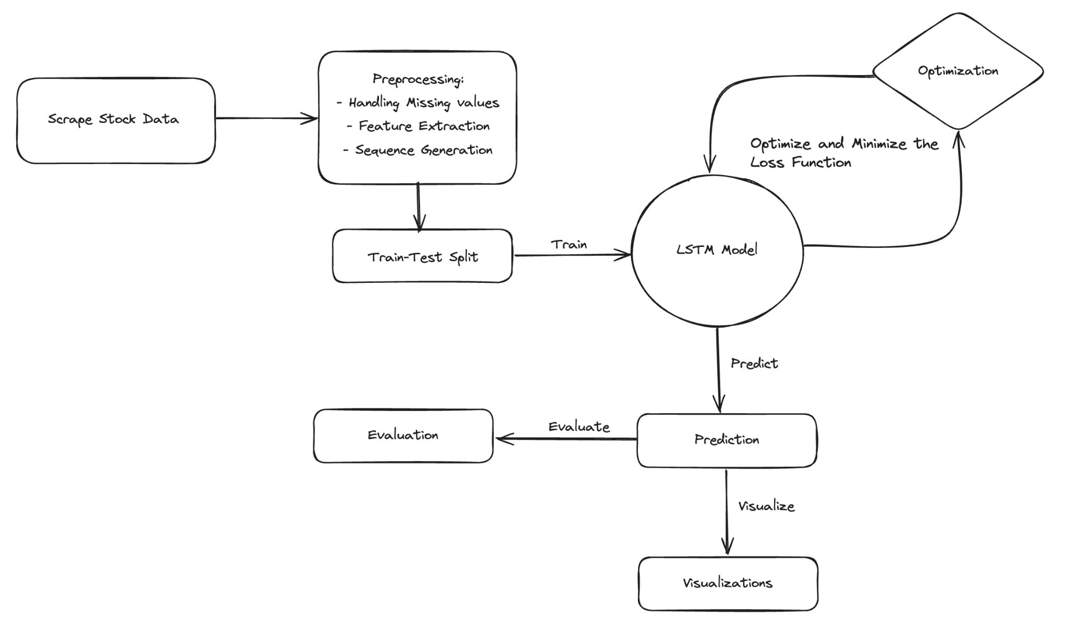
Workflow

Slide 8
Workflow
Data Scraping: The required data for this project was gathered through web scraping from ShareSansar, a prominent stock-related website of Nepal
Preprocessing: During this phase, missing values were addressed, relevant features were extracted, and sequences were prepared for the LSTM model prior to training.
Train-Test Split: The dataset was divided into two parts: the training set and the testing set. Additionally, 10% of the training set was reserved for validation.
Training: The model was trained using the Huber loss function for optimization, with an early stopping mechanism implemented to ensure optimal performance.
Prediction and Evaluation: After training, the model was used to make predictions on the test set. Performance was evaluated using relevant metrics (e.g., accuracy, precision, recall, or RMSE) to assess the model's effectiveness in real-world scenarios.

Slide 9
Preprocessing
Feature Extraction: Technical indicators like RSI and EMA were added, along with the Target feature (daily price movement) and a binary TargetClass to predict the next day's price direction. The Target was shifted to forecast future movements.
Scaling & Sequence Generation: All numerical features were scaled using a Min-Max scaler to normalize them within a range of 0 to 1, improving model stability and convergence. Sequences required by the LSTM model were then generated using a function.
Handling Missing Values: Missing values were imputed using appropriate methods, such as forward/backward-fill for price data, ensuring dataset continuity. Proper imputation is crucial to avoid discrepancies in the model.

Slide 10
Modeling
Input Layer: The model receives sequences of 30 days' worth of features, including historical prices and technical indicators, with an input shape of (30, 9), where 9 represents the number of features.
LSTM Layer: The model has 3 LSTM layers: the first with 256 units and return_sequences=True, the second with 128 units and return_sequences=True, and the third with 64 units & return_sequences=False for the final output.
Dense Layers: The model includes two Dense layers: the first with 128 units and ReLU activation, and the second with 64 units and ReLU activation, refining features for the final stock price prediction.
Output Layer: The final Dense layer outputs the predicted stock price for the next day, with a tanh activation function applied to scale the predictions.

Slide 11
Optimization
Overview: The Adam Optimizer was employed to minimize the loss function during the training.
Why Adam Optimizer?
Adaptive Learning Rate:
Adjusts the learning rate dynamically, improving
convergence efficiency.
Ideal for LSTM Networks:
Adam optimizer’s capabilities in managing learning rates and gradients make it particularly effective for training deep learning models like Long Short-Term Memory (LSTM) Networks.

Slide 12
Results
Table : Actual vs. Predicted Comparison Table
Actual Price | Predicted Price (Model)
295.0 | 316.98
302.0 | 335.95
297.0 | 313.79
297.3 | 294.58
298.0 | 288.08
303.0 | 287.82
300.0 | 289.8
298.8 | 293.48
311.9 | 295.96
216.5 | 295.95

Slide 13
Conclusion & Summary
Prediction Accuracy:
The LSTM model demonstrated decent accuracy in predicting stock prices.
Performance Metrics:
Mean Absolute Error (MAE): 0.00895
Mean Squared Error (MSE): 0.00014
Root Mean Squared Error (RMSE): 0.01190
R2 Score:
The R2 score of 0.9727 was achieved indicating the model explained 97.27% of the variance in the data.
Conclusion:
The model successfully learned the temporal dependencies in the stock market data, resulting in reliable predictions.

